Slide 1
– Reading Recap and Discussion –
BIOS27815: Infectious Diseases
Introduction to metagenomic Next Generation Sequencing (mNGS) in Global Health
UChicago Center in Paris
Paris, France
January 2025

Slide 2
Goals for this lecture
To introduce mNGS in Global Health
To introduce and interpret Bohl et al. 2022

Slide 3
Goals for this lecture
To introduce mNGS in Global Health
To introduce and interpret Bohl et al. 2022

Slide 4
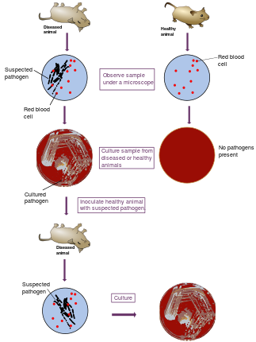
Remember Koch’s postulates….

Slide 5
Remember Koch’s postulates….
Pathogens and parasites cause disease.
But how do we know what pathogen causes which disease?

Slide 6
Remember Koch’s postulates….
Pathogens and parasites cause disease.
But how do we know what pathogen causes which disease?

Slide 7
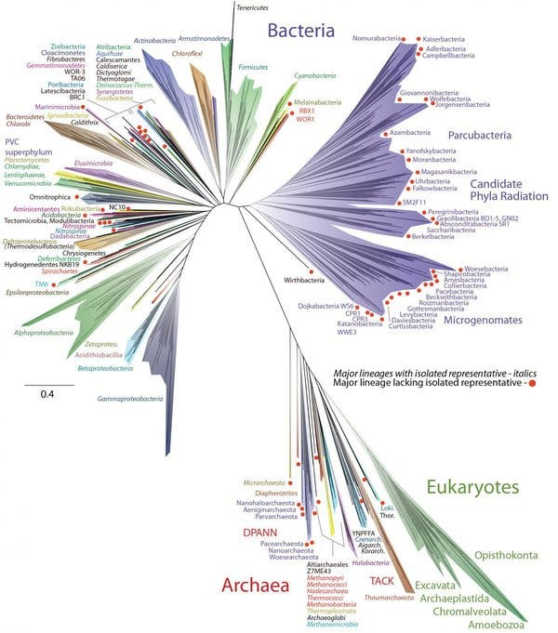
Remember Koch’s postulates….
Pathogens and parasites cause disease.
But how do we know what pathogen causes which disease?
How do we get here???

Slide 8
How do we know what pathogen causes which disease?

Slide 9
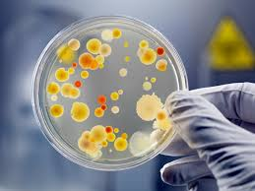

How do we know what pathogen causes which disease?
microscopy
culture with microscopy
antibody tests (e.g. ELISAs)
nucleic acid tests (e.g. PCR)
sequencing
Notes:
enzyme-linked immunosorbent assay

Slide 10
How do we know what pathogen causes which disease?
microscopy
culture with microscopy
antibody tests (e.g. ELISAs)
nucleic acid tests (e.g. PCR)
sequencing
Only sequencing gives us a unique “name” for each pathogen.
Notes:
enzyme-linked immunosorbent assay

Slide 11
How do we know what pathogen causes which disease?
microscopy
culture with microscopy
antibody tests (e.g. ELISAs)
nucleic acid tests (e.g. PCR)
sequencing
Only sequencing gives us a unique “name” for each pathogen.
‘Library prep’ is the preparation of a sample for sequencing.
Notes:
enzyme-linked immunosorbent assay

Slide 12
What is sequencing?

Slide 13
What is sequencing?
Sequencing determines the order of the four nucleotide bases (A, T, G and C) that make up DNA
The first DNA sequences were obtained in the early 1970s. Since then, technology has advanced significantly
Human Genome Project: October 1990 – April 2003
$2.7 billion
Mostly Sanger sequencing
Today, human genomes are sequenced rapidly and cheaply ($100s) and much less for smaller organisms (e.g. viruses)

Slide 14
What is sequencing?
Sequencing determines the order of the four nucleotide bases (A, T, G and C) that make up DNA
The first DNA sequences were obtained in the early 1970s. Since then, technology has advanced significantly
Human Genome Project: October 1990 – April 2003
$2.7 billion
Mostly Sanger sequencing
Today, human genomes are sequenced rapidly and cheaply ($100s) and much less for smaller organisms (e.g. viruses)

Slide 15
What is sequencing?
Sequencing determines the order of the four nucleotide bases (A, T, G and C) that make up DNA
The first DNA sequences were obtained in the early 1970s. Since then, technology has advanced significantly
Human Genome Project: October 1990 – April 2003
$2.7 billion
Mostly Sanger sequencing
Today, human genomes are sequenced rapidly and cheaply ($100s) and much less for smaller organisms (e.g. viruses)
Often using ‘Next Generation Sequencing’ (NGS) techniques

Slide 16
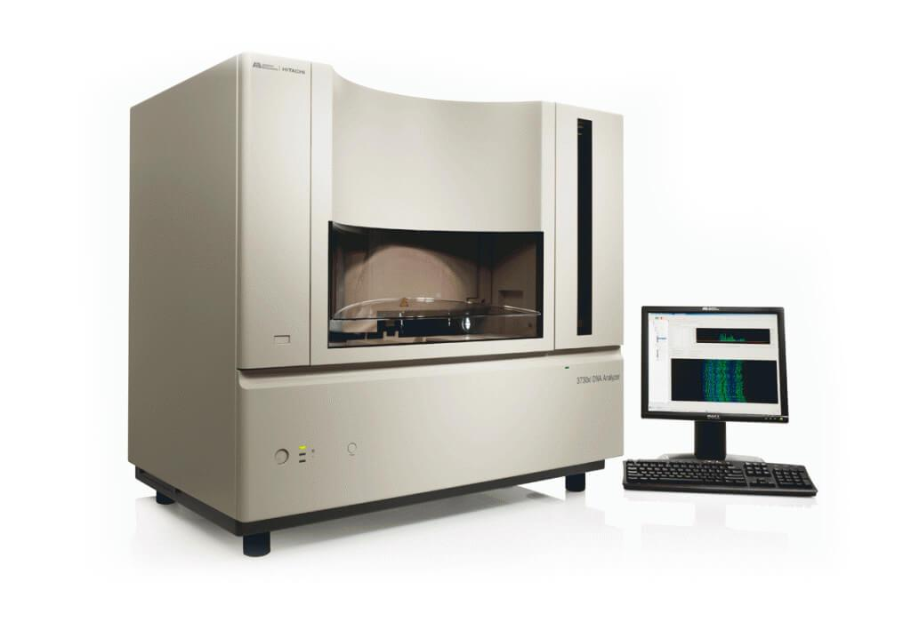
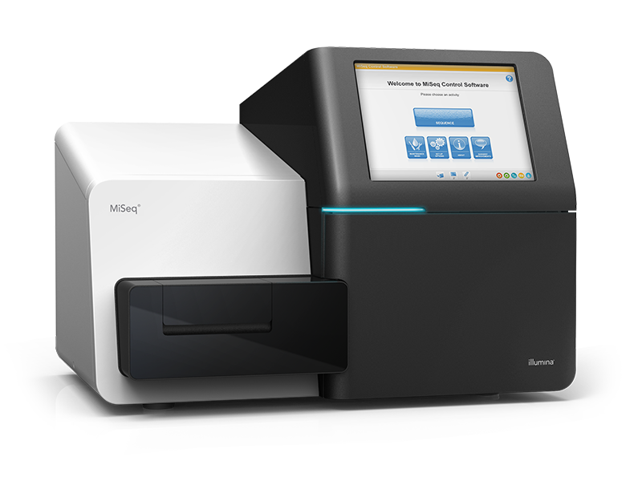
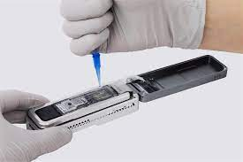
What is sequencing?
Sanger
Illumina (short-read)
Nanopore (long-read)

Slide 17
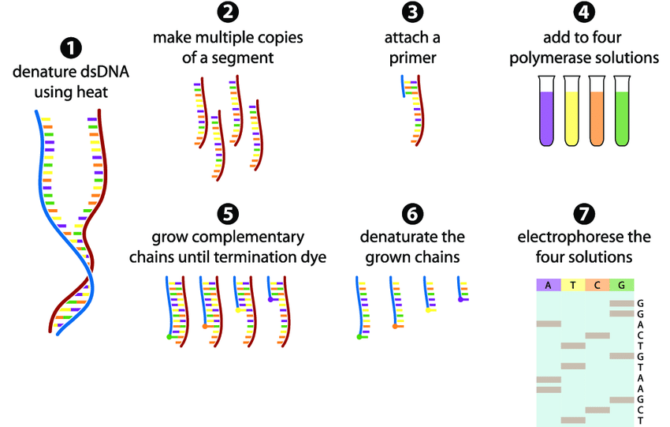
Sanger Sequencing
The DNA sample is divided into four separate reactions, containing all four of the standard deoxynucleotides (dATP, dGTP, dCTP and dTTP) and a DNA polymerase (which attached the dNTPs)
To each reaction is added only one dideoxynucleotides (ddATP, ddGTP, ddCTP, or ddTTP)
Four separate reactions are needed in this process to test all four ddNTPs
The ddNTP stops the DNA polymerase when it comes to a base of that type (e.g. A, T, G, C)
The fragments are then run on a gel. The smallest move through the gel furthest and the ‘ladder’ shows the sequence of the DNA
https://www.youtube.com/watch?v=FvHRio1yyhQ&t=171s

Slide 18
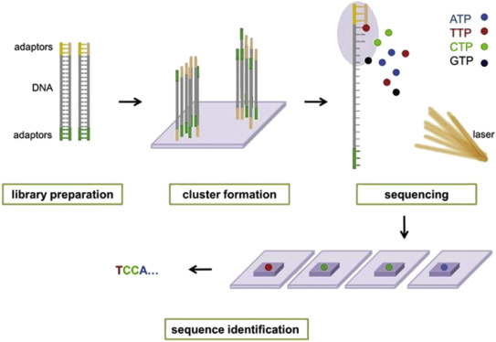
Illumina (short read) Sequencing
Sequencing by synthesis
‘Short read’ technology – DNA is cut up into 200-600 bp chunks
The DNA is amplified, so there are lots of copies of the chunks
They are denatured, then fluorescent complimentary bases are attached
These fluoresce different colours, which is recorded, and the sequence is identified
https://www.youtube.com/watch?v=womKfikWlxM

Slide 19
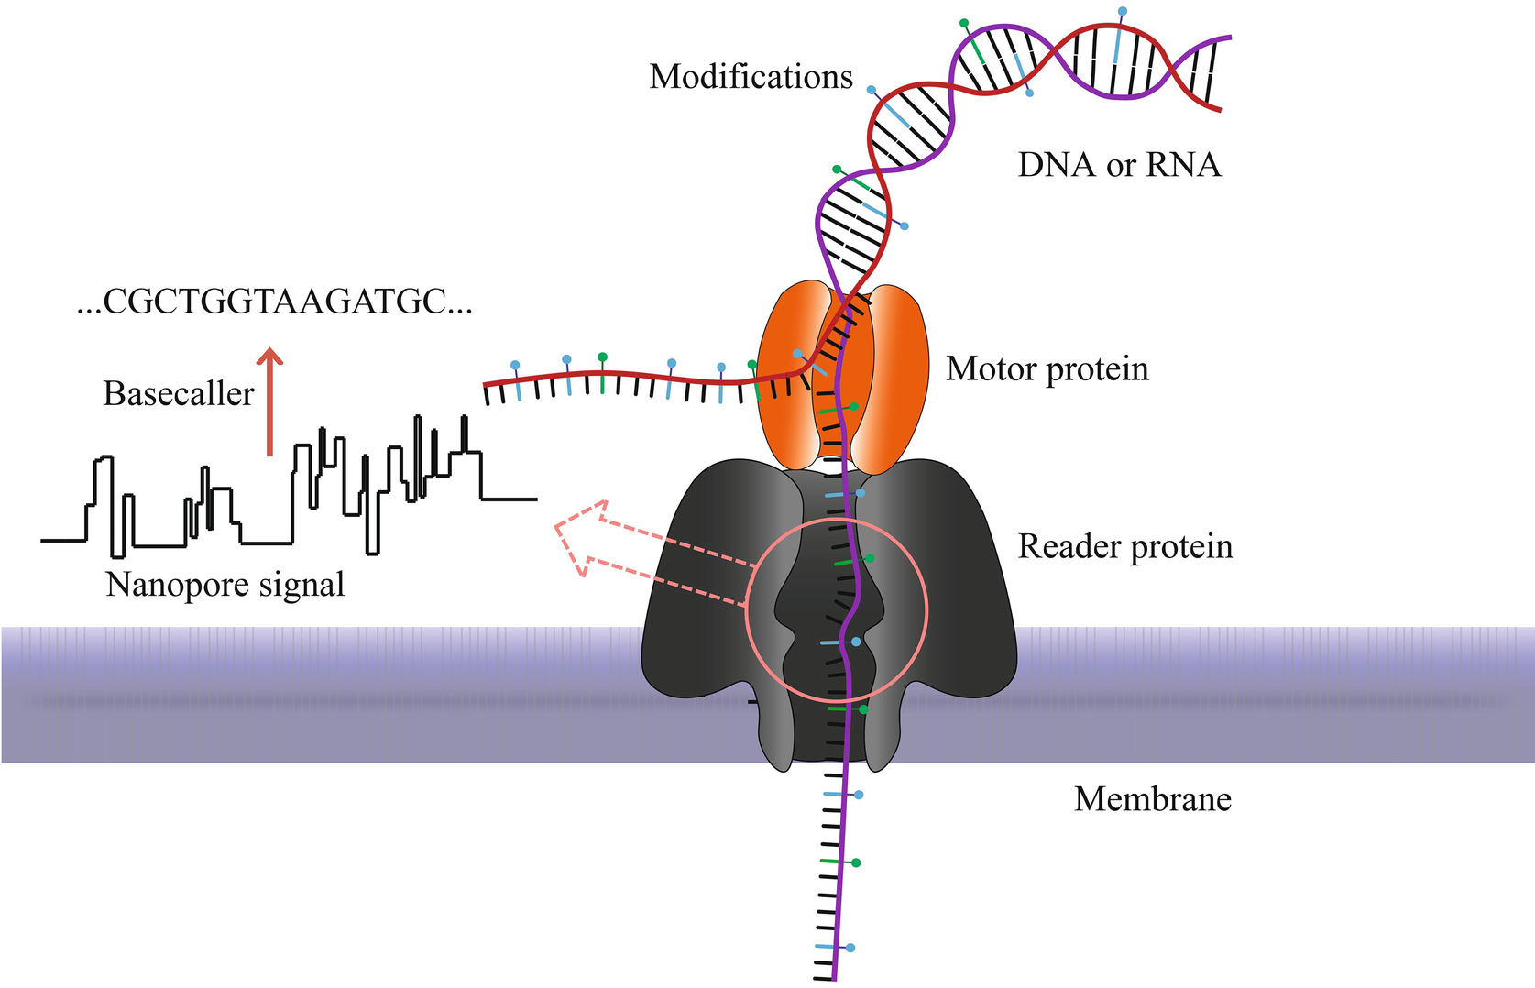
Nanopore (long read) Sequencing
‘Long read’ technology
A DNA library is prepared (proteins are added)
Nucleic acids are passed through a protein nanopore
As the different bases move through the nanopore, it creates a different electrical signal
These resulting changes in the electrical signal is decoded to provide the specific DNA or RNA sequence
https://www.youtube.com/watch?v=RcP85JHLmnI&t=18s

Slide 20
Where do these sequences go once we have them?
Nextclade: genome quality and curation
GISAID: Global Initiative on Sharing All Influenza Data
NCBI: National Center for Biotechnology Information

Slide 21
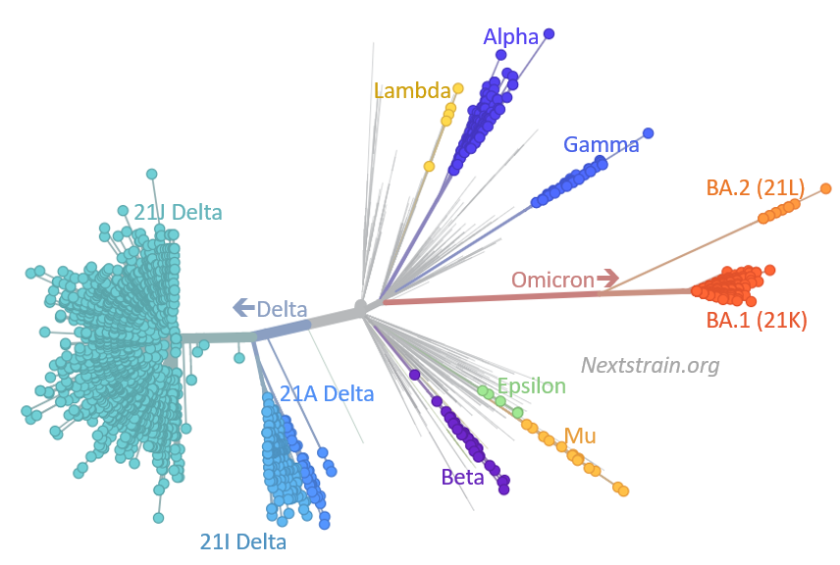
Where do these sequences go once we have them?
Nextclade: genome quality and curation
GISAID: Global Initiative on Sharing All Influenza Data
NCBI: National Center for Biotechnology Information
Publicly available ‘background’ sequences are critical for public health inference.
Lowe 2022

Slide 22
What is metagenomic NGS (mNGS)?

Slide 23
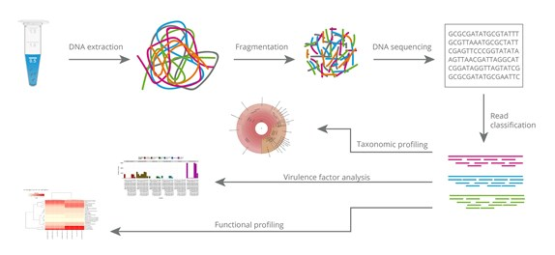
What is metagenomic NGS (mNGS)?
mNGS is the sequencing of ALL genetic material recovered directly from environmental or clinical samples.
This is in contrast to ‘amplicon’ sequencing which uses primer targets to sequence only material of an organism (e.g. pathogen) of interest.
mNGS requires both laboratory and bioinformatics expertise.
nucleic acid (DNA) extraction
fragmentation (short-read)
read classification
sequencing

Slide 24
What is metagenomic NGS (mNGS)?
mNGS is the sequencing of ALL genetic material recovered directly from environmental or clinical samples.
This is in contrast to ‘amplicon’ sequencing which uses primer targets to sequence only material of an organism (e.g. pathogen) of interest.
mNGS requires both laboratory and bioinformatics expertise.

Slide 25
What is metagenomic NGS (mNGS)?
mNGS is the sequencing of ALL genetic material recovered directly from environmental or clinical samples.
This is in contrast to ‘amplicon’ sequencing which uses primer targets to sequence only material of an organism (e.g. pathogen) of interest.
mNGS requires both laboratory and bioinformatics expertise.

Slide 26
What is metagenomic NGS (mNGS)?
mNGS is the sequencing of ALL genetic material recovered directly from environmental or clinical samples.
This is in contrast to ‘amplicon’ sequencing which uses primer targets to sequence only material of an organism (e.g. pathogen) of interest.
mNGS requires both laboratory and bioinformatics expertise.
mNGS is particularly useful for identifying the etiology of viral disease because there is no single gene common across all viral genomes (in contrast to bacteria and protozoa, e.g. 16S)

Slide 27


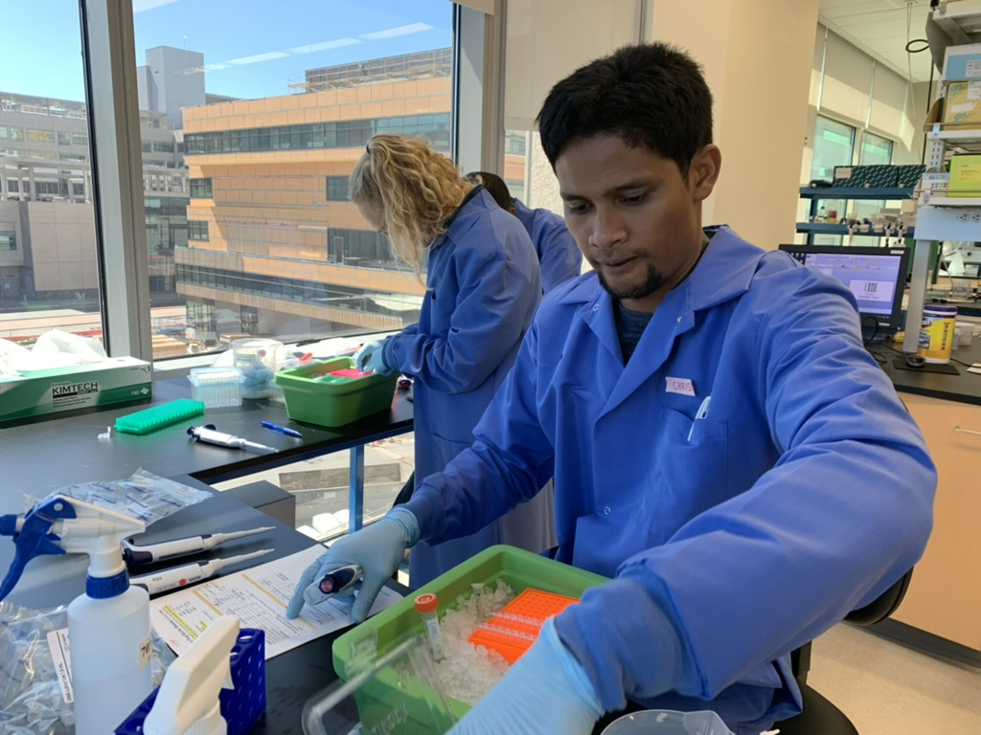
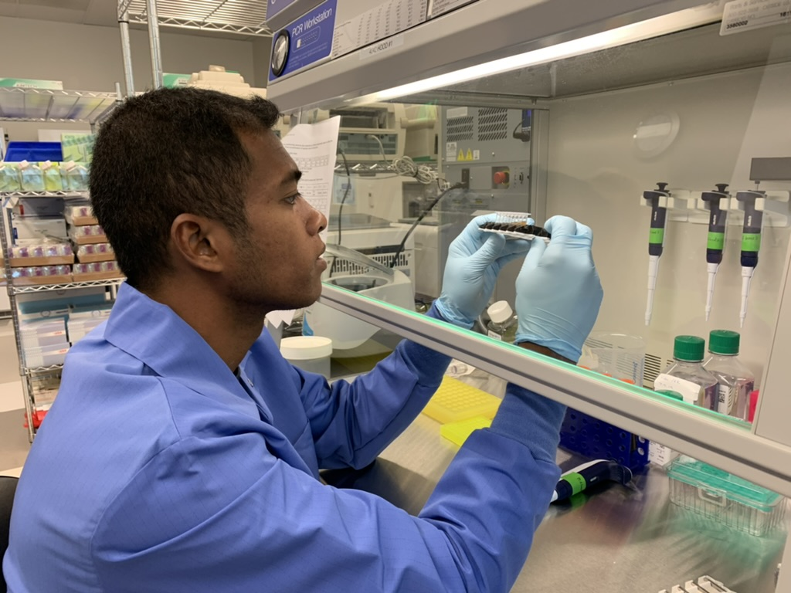
Why mNGS for LMICs?
One protocol with nearly limitless applications!
No need for multiple kits and reagents to be ordered and testing
Training pipeline is discrete and powerful
Computational tools for accessibility are becoming more readily available (e.g. CZID).
Still many challenges:
Expense!
Supply chain
Difficulty of bioinformatics analysis

Slide 28
Goals for this lecture
To introduce mNGS in Global Health
To introduce and interpret Bohl et al. 2022

Slide 29

mNGS in Global Health:

Slide 30
What did Bohl et al. do?

Slide 31
What did Bohl et al. do?
Used mNGS to identify the etiology of febrile disease among patients in periurban Kampong Speu province, Cambodia
Add map from Berkeley talk

Slide 32
How did Bohl et al. do it?
Field
Collected serum samples from febrile patients in Kampong Speu, Cambodia
Patients 6 months – 65 years
Fever 38+⁰C
Samples derived from two groups:
‘community’ study (childhood cohort study + ‘sick visits’)
‘hospital’ study
23 afebrile child control samples from community study

Slide 33
How did Bohl et al. do it?
Lab
Sample 5ml whole blood
Centrifuge to serum
RNA extraction
Library preparation
mNGS
(with host RNA deletion )
Clinical validation where possible
Field
Collected serum samples from febrile patients in Kampong Speu, Cambodia
Patients 6 months – 65 years
Fever 38+⁰C
Samples derived from two groups:
‘community’ study (childhood cohort study + ‘sick visits’)
‘hospital’ study
23 afebrile child control samples from community study

Slide 34
How did Bohl et al. do it?
Bioinformatics
CZID
Pathogen ID via Z-score criteria
Collection of geospatial Google Earth data

Slide 35
How did Bohl et al. do it?
Bioinformatics
CZID
Pathogen ID via Z-score criteria
Collection of geospatial Google Earth data
Statistics
Response: infection with a vector-borne pathogen
Predictors: Demographic attributes of the patient + geospatial features of the patient’s locality

Slide 36
Why did Bohl et al. perform their study?

Slide 37
Why did Bohl et al. perform their study?
To identify unrecognized causes of fever in an under-resourced setting

Slide 38
Why did Bohl et al. perform their study?
To identify unrecognized causes of fever in an under-resourced setting
What did they find?

Slide 39
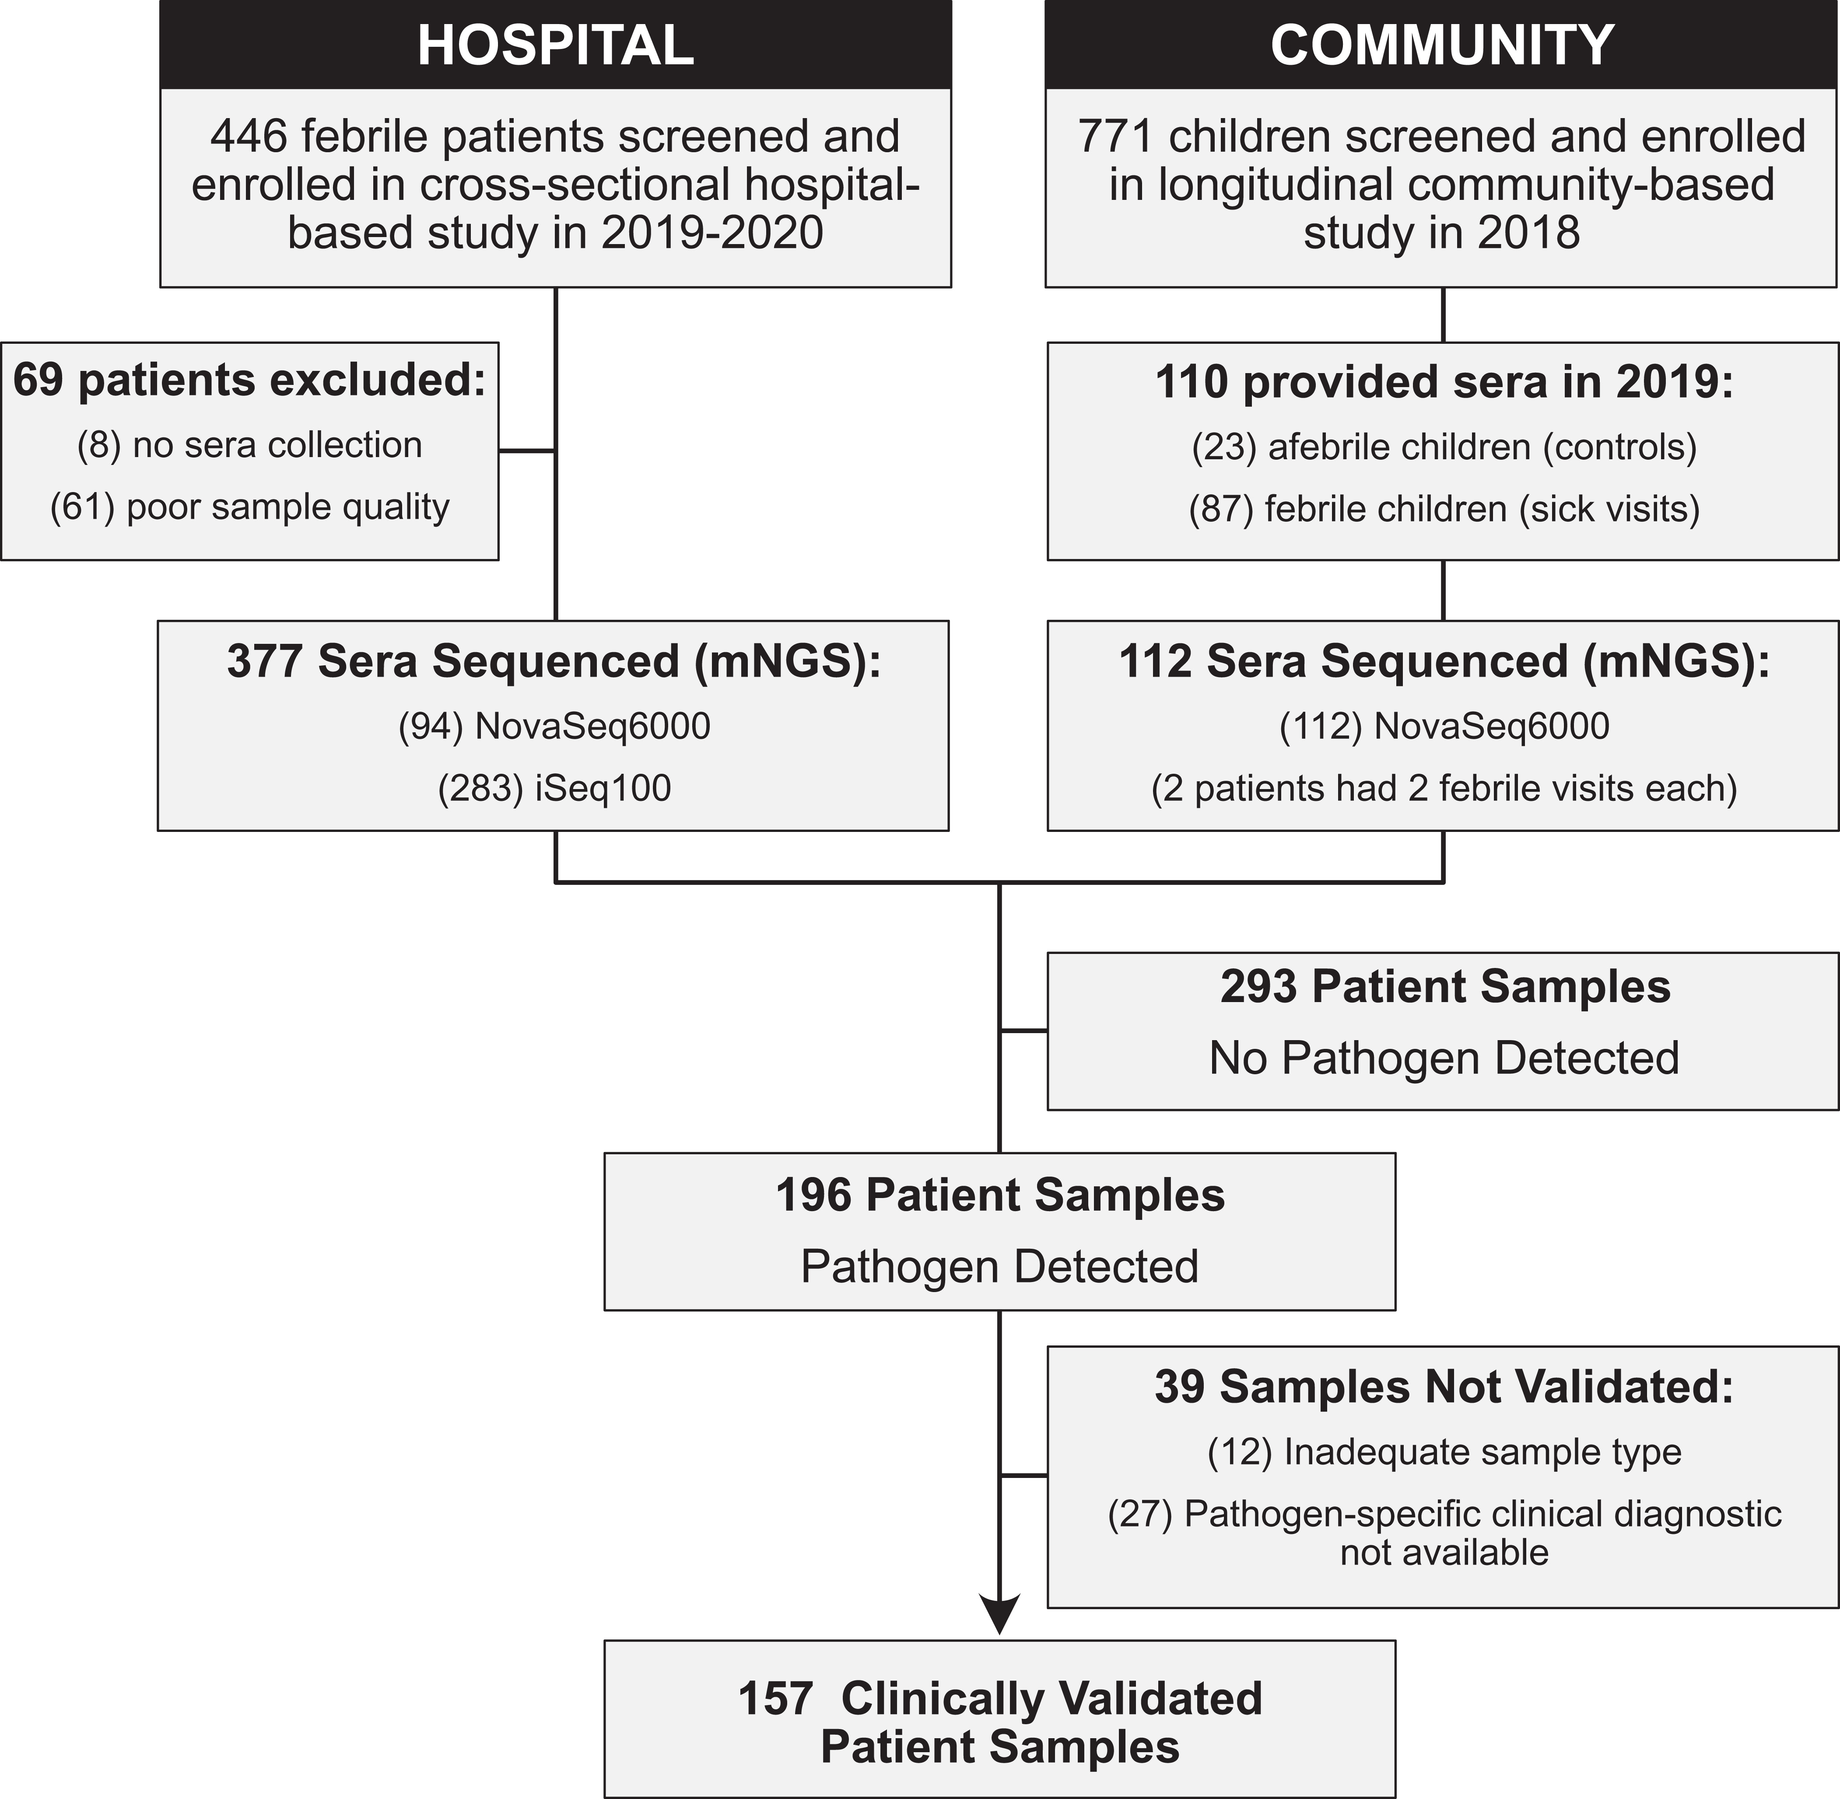
Results.
Fig. 1: study design

Slide 40
Results.
Fig. 1: study design

Slide 41
Results.
Fig. 1: study design

Slide 42
Results.
Fig. 1: study design

Slide 43
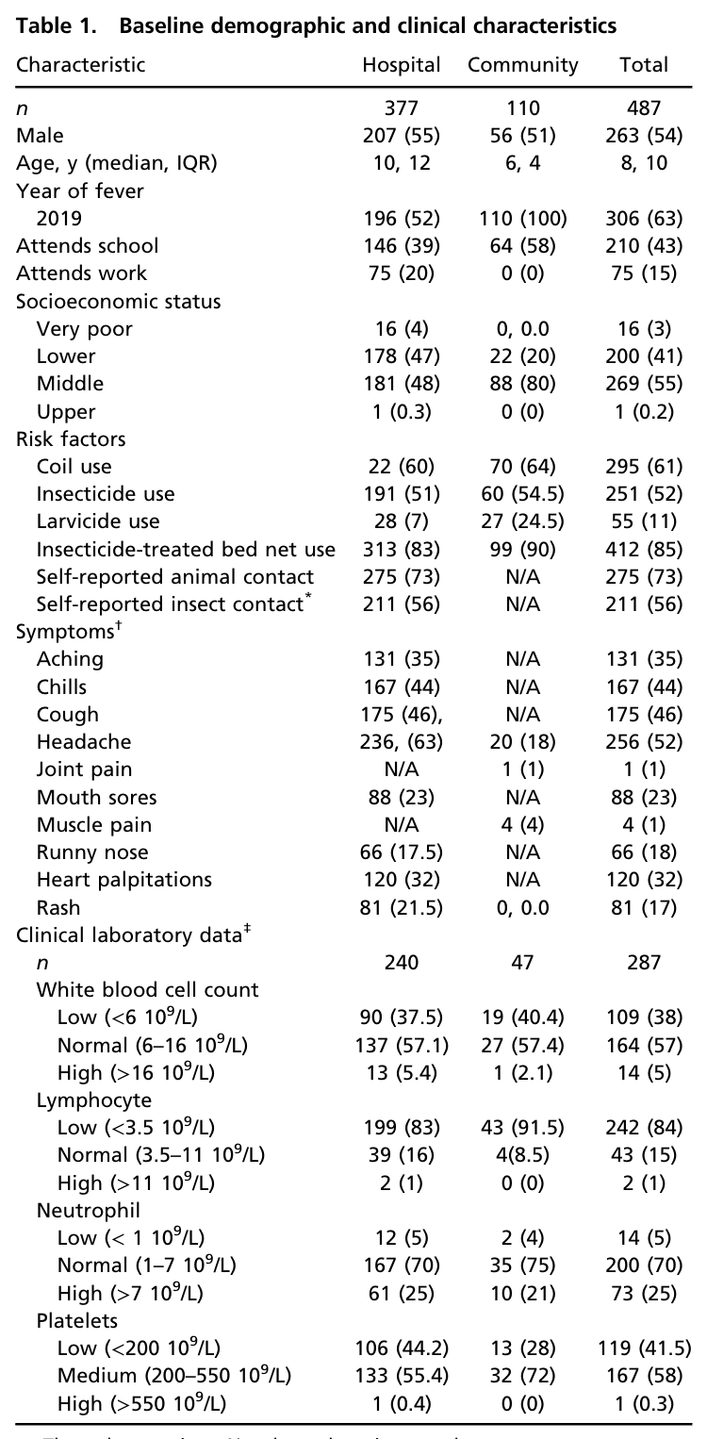
Results.
Table 1: cohort characteristics

Slide 44
Results.
Table 1: cohort characteristics
Notes:
Young patients (median 10 yrs in hospital and 6 years in community)
predominant symptom = headache (52.4%)
approximately half of hospital cohort reported insect exposure, primarily mosquitos
three-quarters of all participants reported animal exposure, chiefly dogs, cats, and chickens, with some rare reports of exposure to pigs and horses

Slide 45
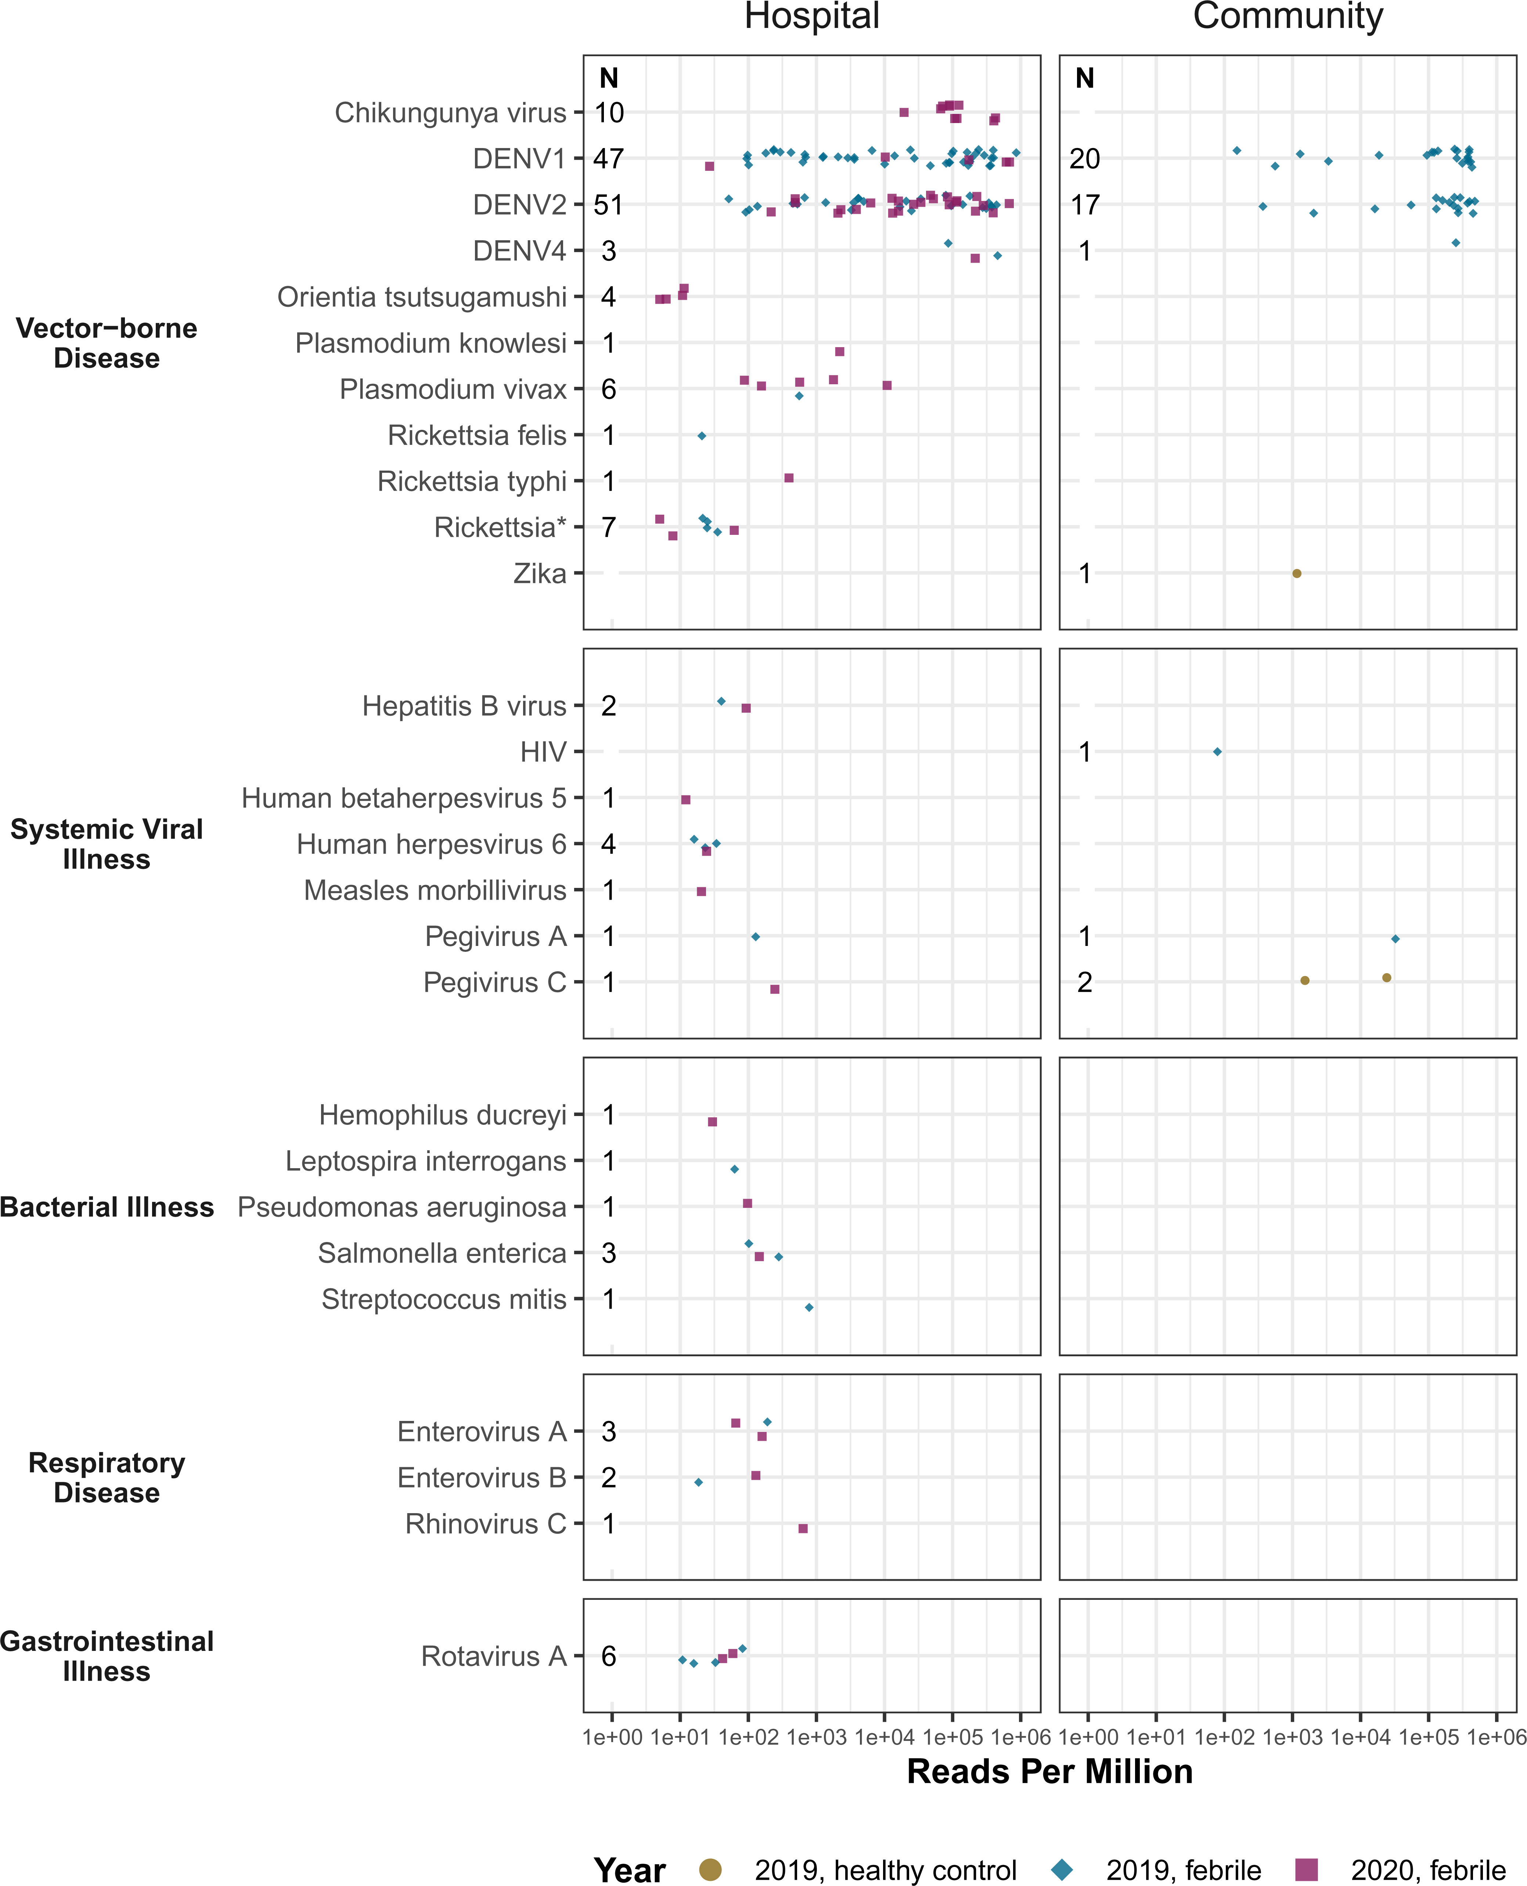
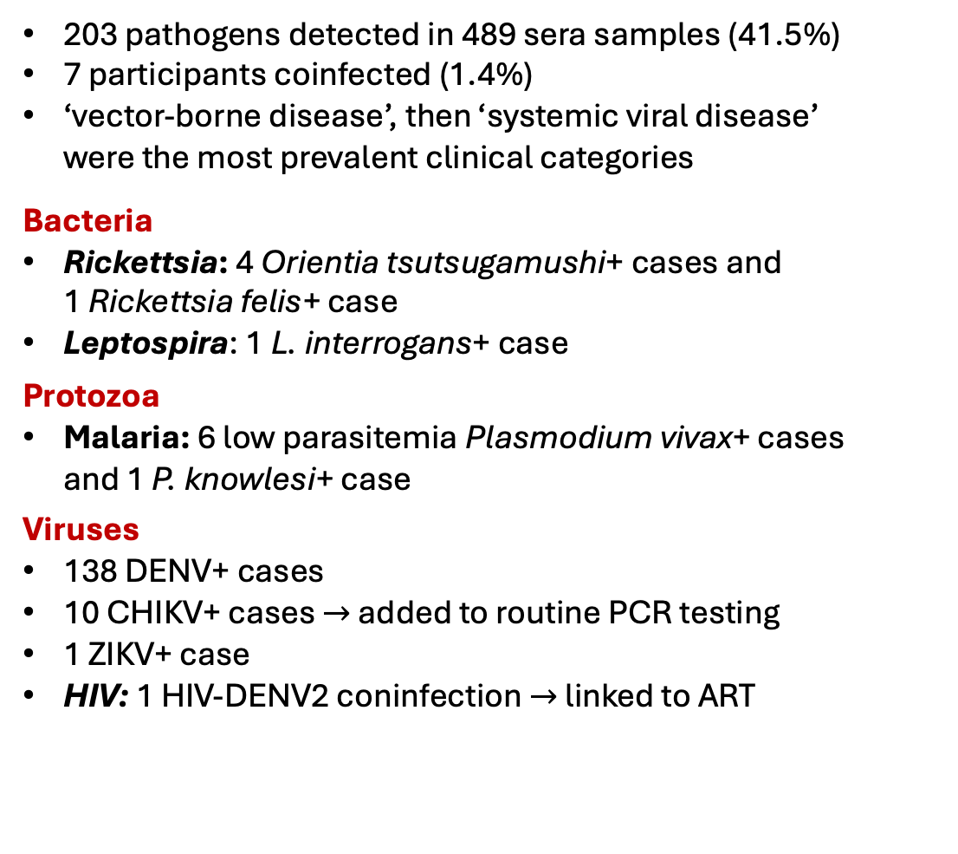
Results.
Fig. 2: pathogens identified
203 pathogens detected in 489 sera samples (41.5%)
7 participants coinfected (1.4%)
‘vector-borne disease’, then ‘systemic viral disease’ were the most prevalent clinical categories
Bacteria
Rickettsia: 4 Orientia tsutsugamushi+ cases and 1 Rickettsia felis+ case
Leptospira: 1 L. interrogans+ case
Protozoa
Malaria: 6 low parasitemia Plasmodium vivax+ cases and 1 P. knowlesi+ case
Viruses
138 DENV+ cases
10 CHIKV+ cases $→$ added to routine PCR testing
1 ZIKV+ case
HIV: 1 HIV-DENV2 coninfection $→$ linked to ART

Slide 46
Results.
Fig. 2: pathogens identified
203 pathogens detected in 489 sera samples (41.5%)
7 participants coinfected (1.4%)
‘vector-borne disease’, then ‘systemic viral disease’ were the most prevalent clinical categories
Bacteria
Rickettsia: 4 Orientia tsutsugamushi+ cases and 1 Rickettsia felis+ case
Leptospira: 1 L. interrogans+ case
Protozoa
Malaria: 6 low parasitemia Plasmodium vivax+ cases and 1 P. knowlesi+ case
Viruses
138 DENV+ cases
10 CHIKV+ cases $→$ added to routine PCR testing
1 ZIKV+ case
HIV: 1 HIV-DENV2 coninfection $→$ linked to ART

Slide 47
Results.
Fig. 2: pathogens identified
203 pathogens detected in 489 sera samples (41.5%)
7 participants coinfected (1.4%)
‘vector-borne disease’, then ‘systemic viral disease’ were the most prevalent clinical categories
Bacteria
Rickettsia: 4 Orientia tsutsugamushi+ cases and 1 Rickettsia felis+ case
Leptospira: 1 L. interrogans+ case
Protozoa
Malaria: 6 low parasitemia Plasmodium vivax+ cases and 1 P. knowlesi+ case
Viruses
138 DENV+ cases
10 CHIKV+ cases $→$ added to routine PCR testing
1 ZIKV+ case
HIV: 1 HIV-DENV2 coninfection $→$ linked to ART

Slide 48
Results.
Fig. 2: pathogens identified
203 pathogens detected in 489 sera samples (41.5%)
7 participants coinfected (1.4%)
‘vector-borne disease’, then ‘systemic viral disease’ were the most prevalent clinical categories
Bacteria
Rickettsia: 4 Orientia tsutsugamushi+ cases and 1 Rickettsia felis+ case
Leptospira: 1 L. interrogans+ case
Protozoa
Malaria: 6 low parasitemia Plasmodium vivax+ cases and 1 P. knowlesi+ case
Viruses
138 DENV+ cases
10 CHIKV+ cases $→$ added to routine PCR testing
1 ZIKV+ case
HIV: 1 HIV-DENV2 coninfection $→$ linked to ART

Slide 49
Results.
Fig. 2: pathogens identified
203 pathogens detected in 489 sera samples (41.5%)
7 participants coinfected (1.4%)
‘vector-borne disease’, then ‘systemic viral disease’ were the most prevalent clinical categories
Bacteria
Rickettsia: 4 Orientia tsutsugamushi+ cases and 1 Rickettsia felis+ case
Leptospira: 1 L. interrogans+ case
Protozoa
Malaria: 6 low parasitemia Plasmodium vivax+ cases and 1 P. knowlesi+ case
Viruses
138 DENV+ cases
10 CHIKV+ cases $→$ added to routine PCR testing
1 ZIKV+ case
HIV: 1 HIV-DENV2 coninfection $→$ linked to ART

Slide 50
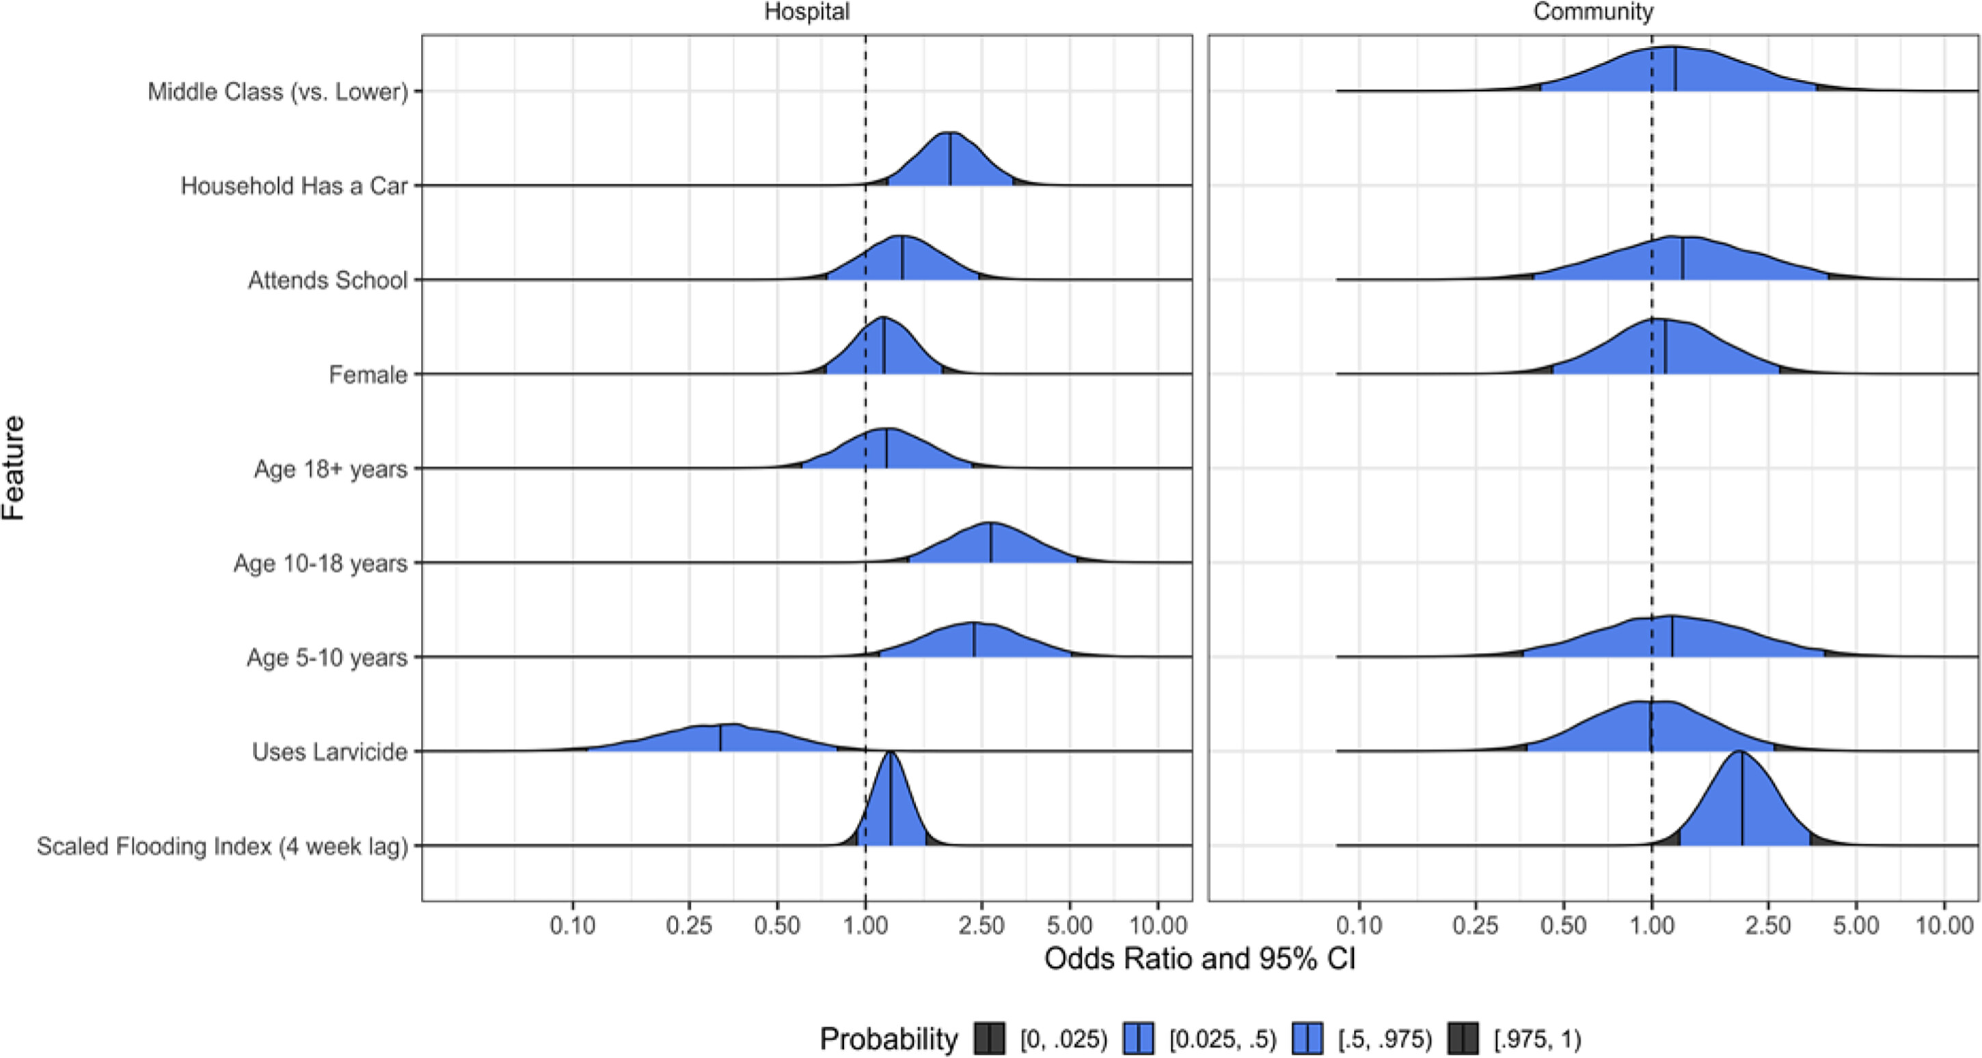
Results.
Fig. 3: correlates of VBD
Notes:
Odds ratio that a patient encounter was attributable to infection by a vector-borne pathogen. Results of multivariate analyses in both patient populations to identify risk factors of contracting vector-borne pathogens.

Slide 51
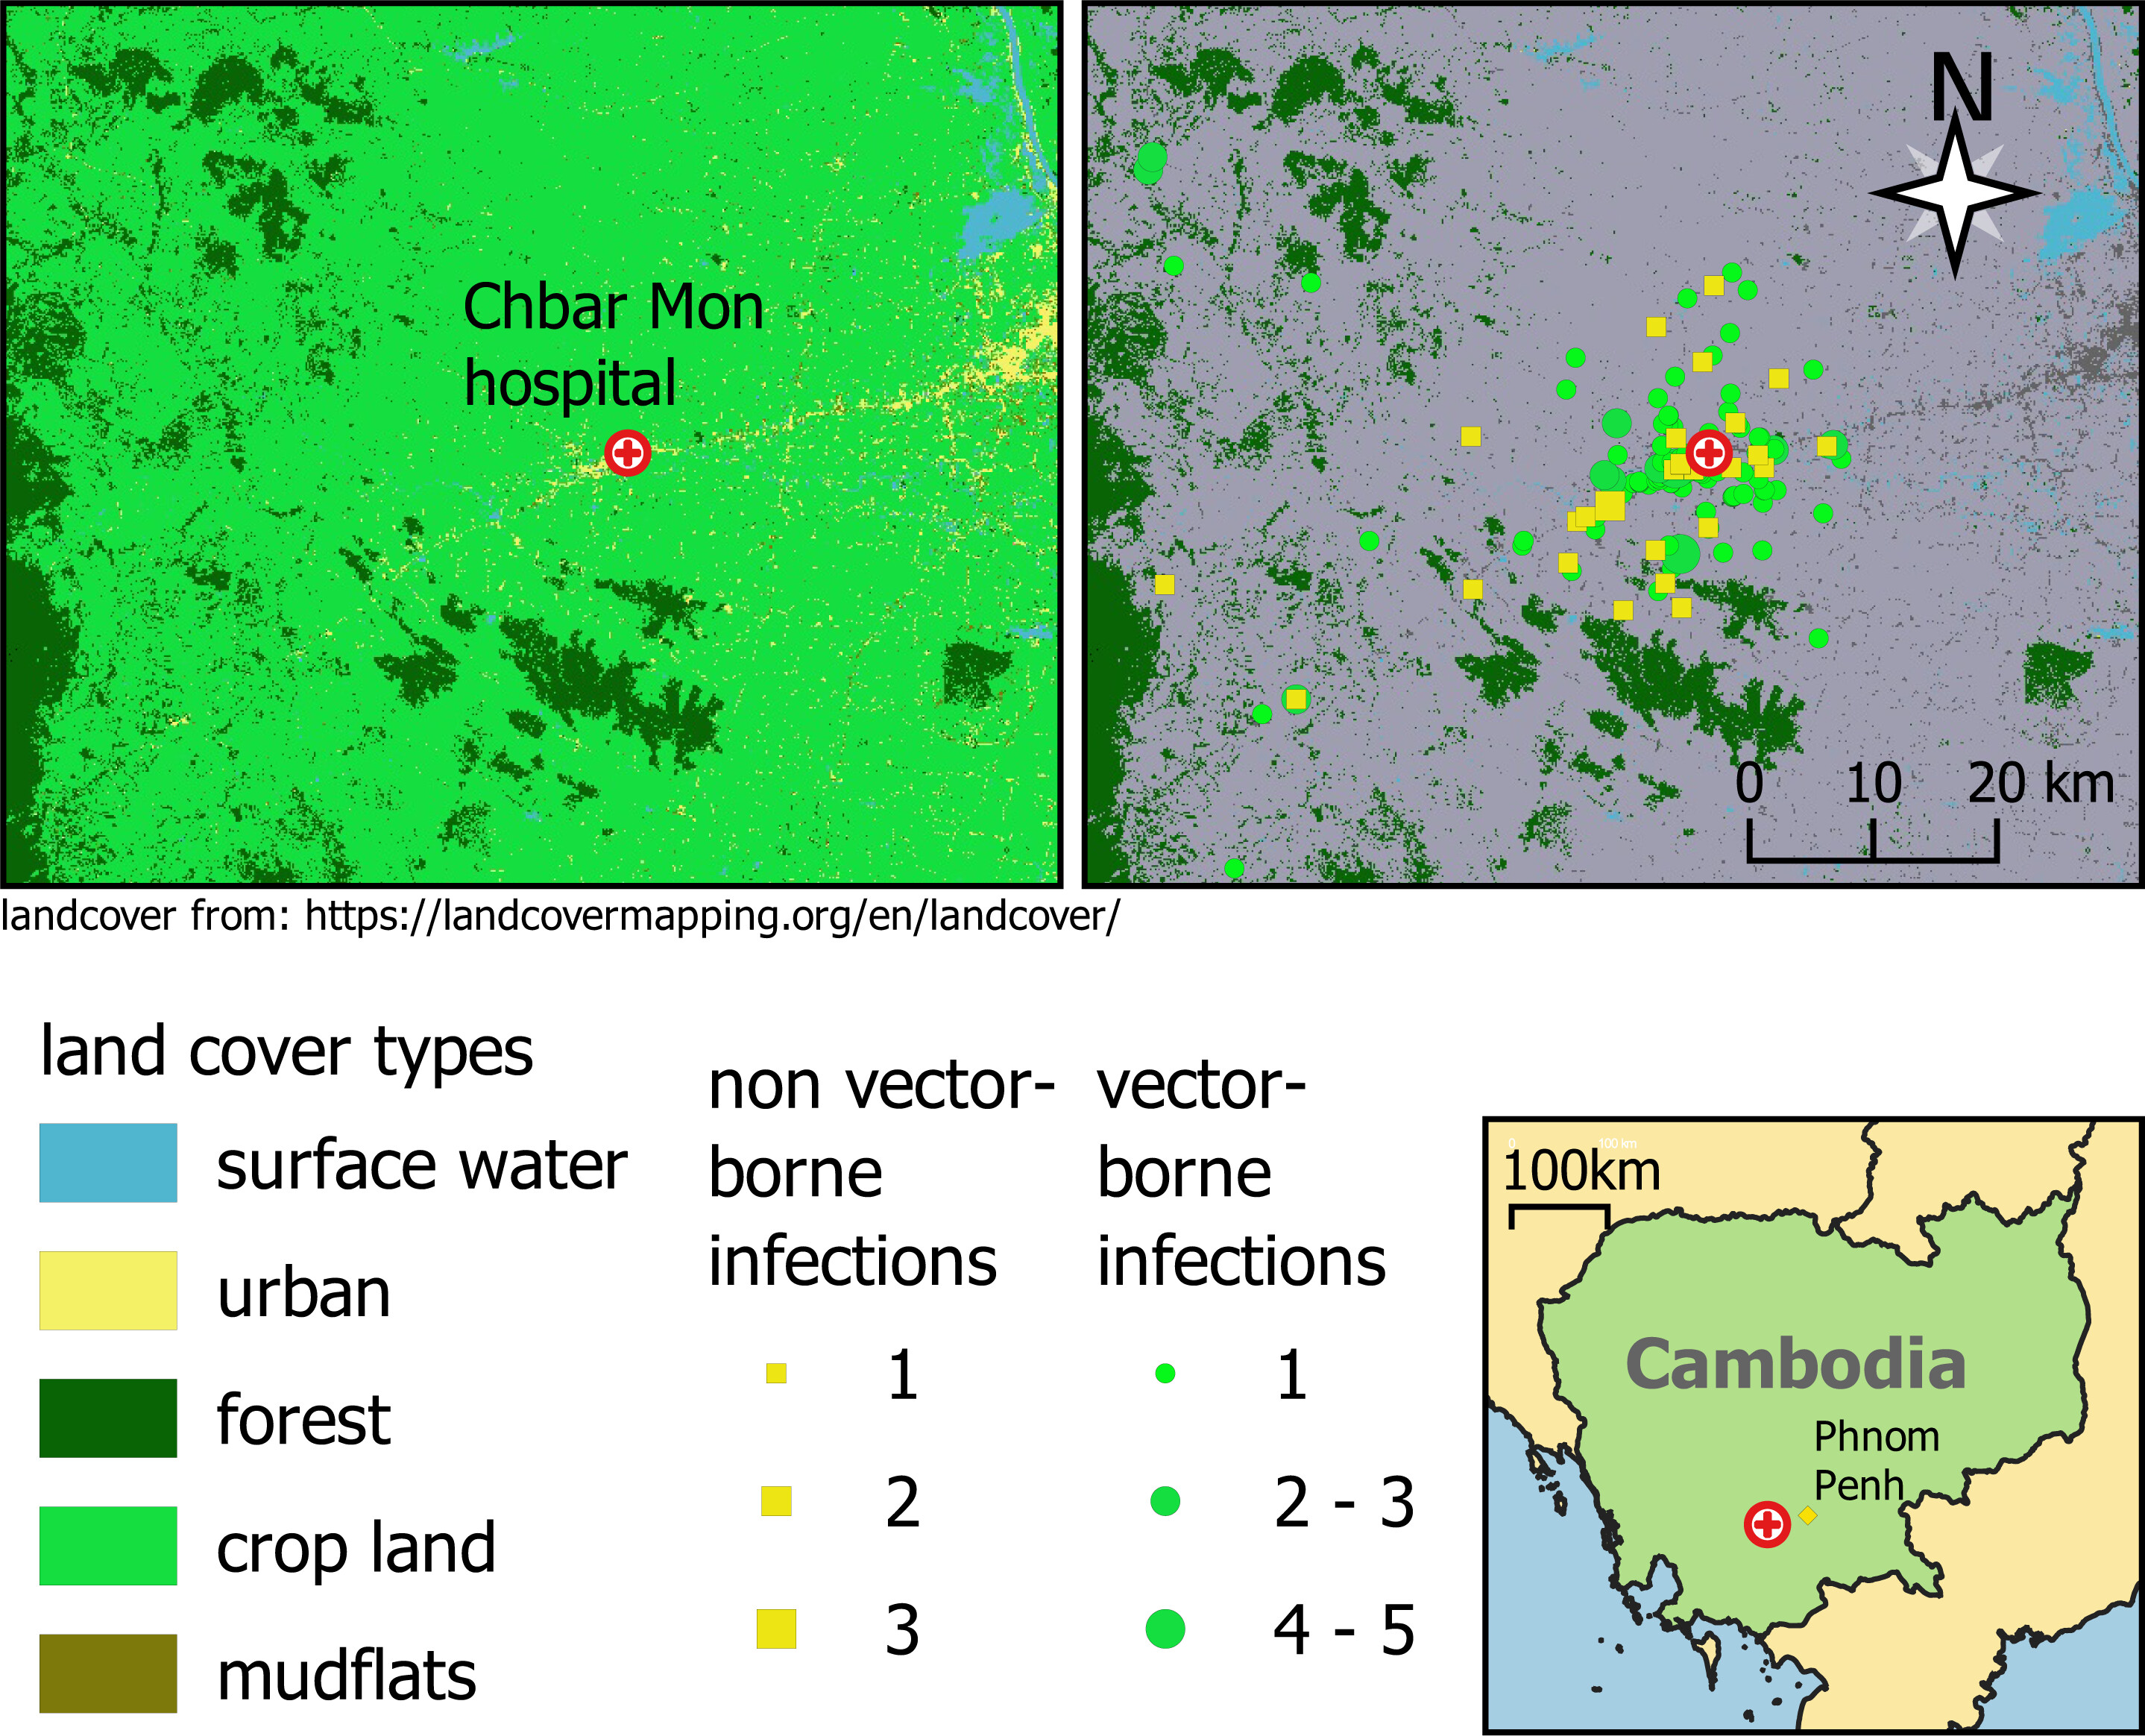
Results.
Fig. 4: geospatial setting
Crop land = predominant land-cover type (89%)
Urban = 2nd most (10%)
Urban participants more likely to have non-VBD (13%) vs. VBD (9%)
Still urban cases of CHIK, DENV1, DENV2, ZIKV
92% DENV cases from crop land

